Slide 1
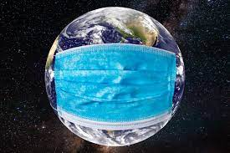

Slide 2
COVID-19:
MACHINE LEARNING ANALYSIS
“How Air Traffic Affected the Spread of Covid-19”
INAKA Jessy Landry
Supervised by Melike Gecer

Slide 3
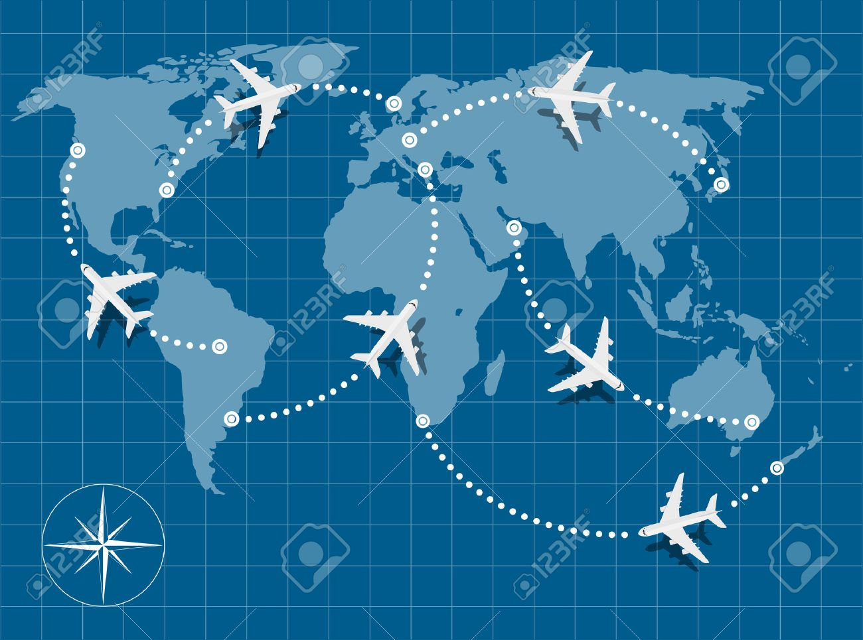

Slide 4
Motivation
The Belief
“How Covid affected the Air Traffic”
The Context
The Problem
“Covid-19 wouldn’t have become a pandemic if not for air travel.”
Relevant Papers focused on Statistical Analysis

Slide 5
Literature
Human Mobility
Covid-19 Modeling
Inflight Spread
Air Traffic as factor

Slide 6
Methodology
Approach 1
Approach 2
Approach 3
Comparison
Examining countries with more arriving international travellers VS with less
Phases and Variants
Analysis of all the 3 Phases
Investigate Alpha && Delta Variants spread
Algorithms and Techniques
Statistical techniques VS Machine Learning (Facebook’s Prophet Algorithm and Neural Network)

Slide 7
Implementation
max growth

Slide 8
Prophet Algorithm
Prophet time series = Trend + Seasonality + Holiday + error
Advantages: Accommodates seasonality with multiple periods. Prophet is resilient to missing values. Fitting of the model is fast. Intuitive hyper parameters which are easy to tune

Slide 9
Reading papers & Sense Making
Initial work on Neural Network
Final Presentation
September to October
15.11.2021
1.12.2021
05.01.2022
11.02.2022
Prophet Algorithm completion
Second Run on Neural Network: Featuring Engg and Tuning
Notes:
Tentative Time Plan

Slide 10
References
Human Mobility Papers:
https://www.researchgate.net/publication/333136406_Urban_Human_Mobility_Data-Driven_Modeling_and_Prediction
https://www.researchgate.net/figure/An-overview-of-data-driven-modeling-and-prediction-for-human-mobility_fig1_333136406
https://ieeexplore.ieee.org/document/709453
COvid measure dataset: https://www.kaggle.com/paultimothymooney/covid19-containment-and-mitigation-measures
Air traffic dataset: https://zenodo.org/record/4670228#.YVQQ7UZBz0q
Covid-19 dataset: https://raw.githubusercontent.com/datasets/covid-19/master/data/time-series-19-covid-combined.csv
https://facebook.github.io/prophet/docs/quick_start.html
https://europepmc.org/article/pmc/pmc7833922 “The influence of passenger air traffic on the spread of COVID-19 in the world.”
www.teenvogue.com
https://www.123rf.com/photo_38313435_picture-of-world-map-with-flying-planes-on-it.html

Slide 11
THANKS !
Questions?

